Slide 1
The Five PARAGRAPH COMPOSITION
Including Information on the construction of a paragraph and creating both a strong introduction and conclusion.

Slide 2
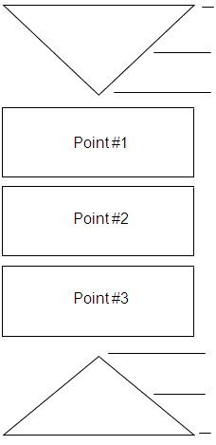
Introduction
The Body
The Conclusion

Slide 3
Introduction
Begin with an ATTENTION-GETTER. The introduction should arouse interest in your reader and bring immediate focus to your subject.
Leads up to the thesis statement (main idea) by giving background information. In the case of literary essays, this means the author, title, and genre.
The thesis statement is a declarative sentence that states the overall point of the essay. Typically, it is the last sentence in the introduction.

Slide 4
How to Write an introduction
Use a quotation
Use a personal anecdote (story)
Use a startling statement
Ask and answer a question
Use a combination of these
**Always include background information relevant to your thesis and necessary for the reader to understand your position.
**Additionally, you will need to include the title of the work of literature and name of the author your paper is analyzing or discussing.

Slide 5
The format of the introduction
Begin with a hook or attention grabber.
Provide background/context (what are you writing about and why should the reader care?)
Give a transition (how does the background connect to your position?)
Thesis Statement (the overall “topic sentence” to your essay)
**The order of these things can be moved around somewhat, but they all need to be present in the introductory paragraph.

Slide 6
Body Development
Each paragraph in the body should begin with a topic sentence, then prove or develop that point with evidence or reasoning. In literary essays, this means citing the text or using quotations as “proof” of your point. Each quotation is then followed by the writer’s explanation or interpretation. Finally, make a closing comment that reasserts the point of the paragraph.
Never leave a quotation “hanging” at the end of a paragraph. Make sure all the major points are in your words.

Slide 7
What does every Single body paragraph need?
Topic Sentence – discusses the main idea of the body paragraph. Think of this as a mini-thesis sentence. It supports the overall thesis statement.
Evidence – this is support that comes directly from your text or research.
Commentary – this is CRUCIAL! The commentary explains the evidence and how it supports your topic sentence, and ultimately the thesis statement.
Reasoning – this is your own reasoning or logic behind your topic sentence.
Transition – this is the sentence that concludes your paragraph and introduces, or links, one paragraph to the ideas to come in the next paragraph.

Slide 8
This is the structure for the basic paragraph. Depending on the assignment given by your teacher, the requirements may change a bit. The order in which you place the reasoning, evidence, commentary, etc., may change, but this basic structure is used for a foundation.

Slide 9
CONCLUSION
The purpose of the conclusion should:
Bring a sense of closure to the topic.
Repeat the idea of your thesis (do not simply restate your thesis)
Summarizes the main points briefly.
Return to the ideas presented in your introduction (what did you use as a hook?). Return to it in the conclusion. This helps to create a full-circle effect for the essay.
Do not present new information.

Slide 10
The format of the conclusion
Restatement of thesis using strong words by stating what was proved in body paragraphs.
Evaluation of what thesis proved, bringing the reader to a higher level of understanding regarding the topic.
Make a connection or reference to the ideas presented as the hook or the background/context presented in the introduction.
**These can be moved around in order, but they all need to be present in the concluding paragraph.

